Slide 1
Hauptspeicher-Datenbanksysteme
Hardware-Entwicklungen
Anwendungsstudie: Handelsunternehmen
Column- versus Row-Store
OLAP&OLTP: Snapshotting
Kompaktifizierung
Mehrbenutzersynchronisation
Hochverfügbarkeit
Indexierung
Multi-Core Anfragebearbeitung

Slide 2
Hauptspeicher-Datenbanksysteme
Disk is Tape, Tape is dead … Jim Gray
Die Zeit ist reif für ein Re-engineering der Datenbanksysteme
Man kann heute für 25000 Euro einen Datenbankserver mit 1 TeraByte Hauptspeicher und 32 Rechenkernen kaufen

Slide 3
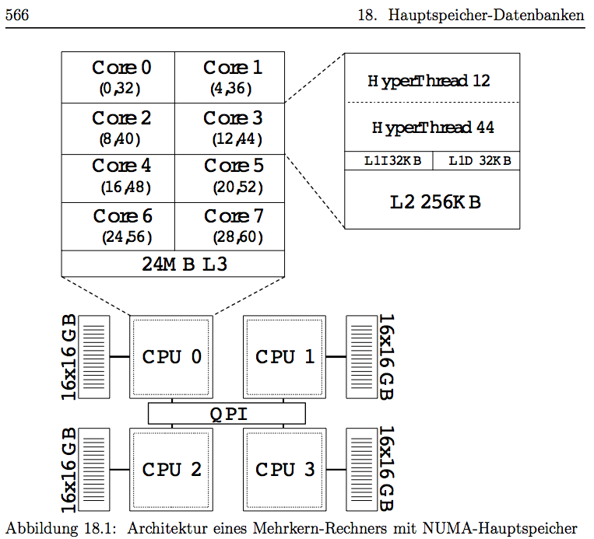
Typical NUMA Multi-Core Server with 1 TB DRAM

Slide 4
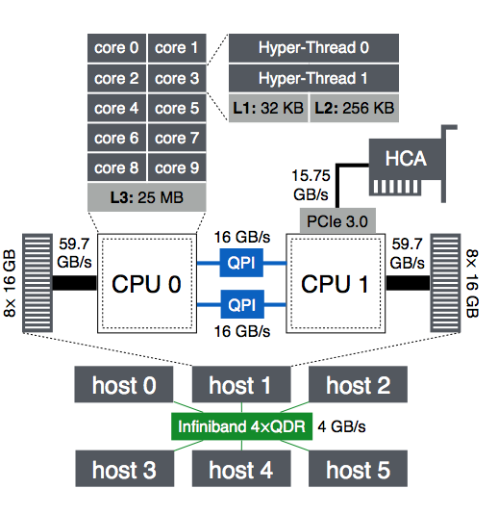
Network in the small and in the large

Slide 5
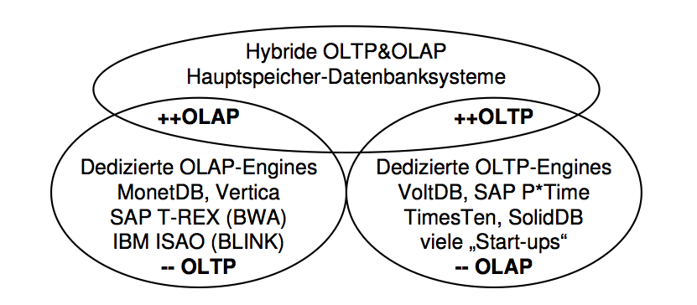
Einsatz von Hauptspeicher-Datenbanksystemen

Slide 6
Machbarkeits“studie“: Main Memory DBMS
Amazon
  Data Volume
    Revenue: 15 billion Euro
    Avg. Item Price: 15 Euro
    1 billion order lines per year
      54 Bytes per order line
      54 GB per year
      + additional data
      - compression
  Transaction Rate
    Avg: 32 orders per s
    Peak rate: Thousands/s
    + inquiries
Intel
  Tera Scale Initiative
  Server with several TB main memory
  We just ordered one from Dell for 49 K Euro
  Main Memory capacity will grow faster than Customers‘ Needs
  Cf. RAMcloud-project at Stanford
    Ousterhoud et al.

Slide 7
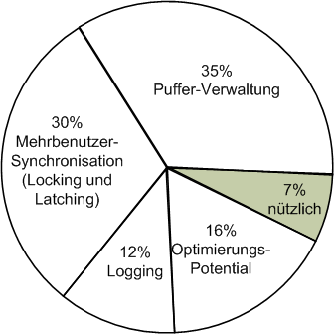
Leistungsengpässe: Profiling eines klassischen Datenbanksystems

Slide 8
Widerholung: Speicherhierarchie
Register
(L1/L2/L3)
Cache
Hauptspeicher
Plattenspeicher
Archivspeicher

Slide 9
Überblick: Speicherhierarchie
Register
(L1/L2/L3)
Cache
Hauptspeicher
Plattenspeicher
Archivspeicher
1 – 8 Byte
Compiler
8 – 128 Byte
Cache-Controller
4 – 64 KB
Betriebssystem
Benutzer

Slide 10
Überblick: Speicherhierarchie
1-10ns
Register
10-100ns
Cache
100-1000ns
Hauptspeicher
10 ms
Plattenspeicher
sec
Archivspeicher
Zugriffslücke
10⁵

Slide 11
Überblick: Speicherhierarchie
1-10ns
Register
10-100ns
Cache
100-1000ns
Hauptspeicher
10 ms
Plattenspeicher
sec
Archivspeicher
Kopf (1min)
Raum (10 min)
München (1.5h)
Pluto (2 Jahre)
Andromeda
(2000 Jahre)
Zugriffslücke
10⁵

Slide 12
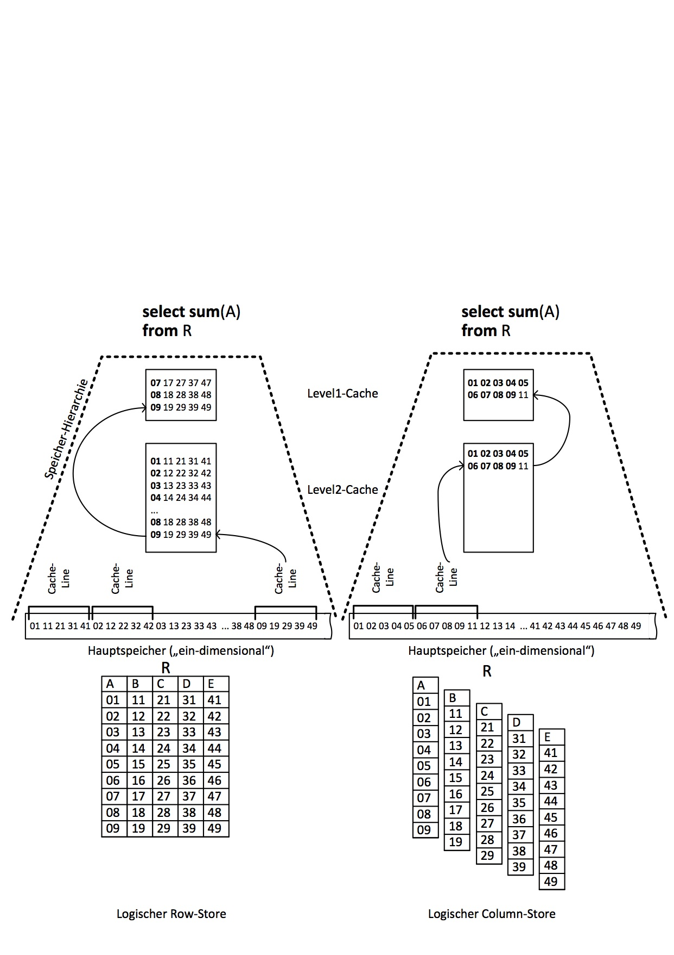
Row- versus
Column-Store

Slide 13
Architektur eines Mehrkernrechners mit NUMA Speicher

Slide 14
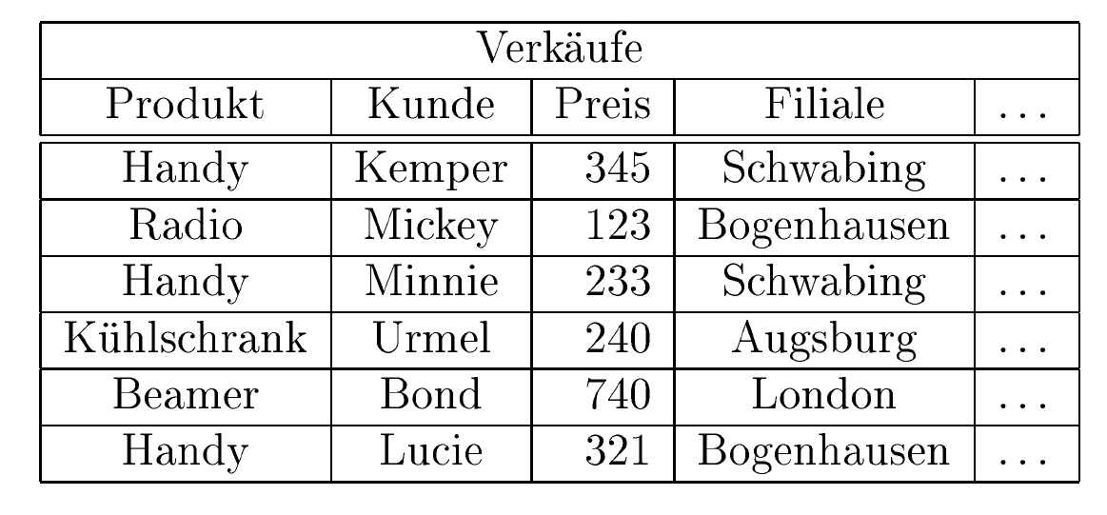
Row Store versus Column Store

Slide 15
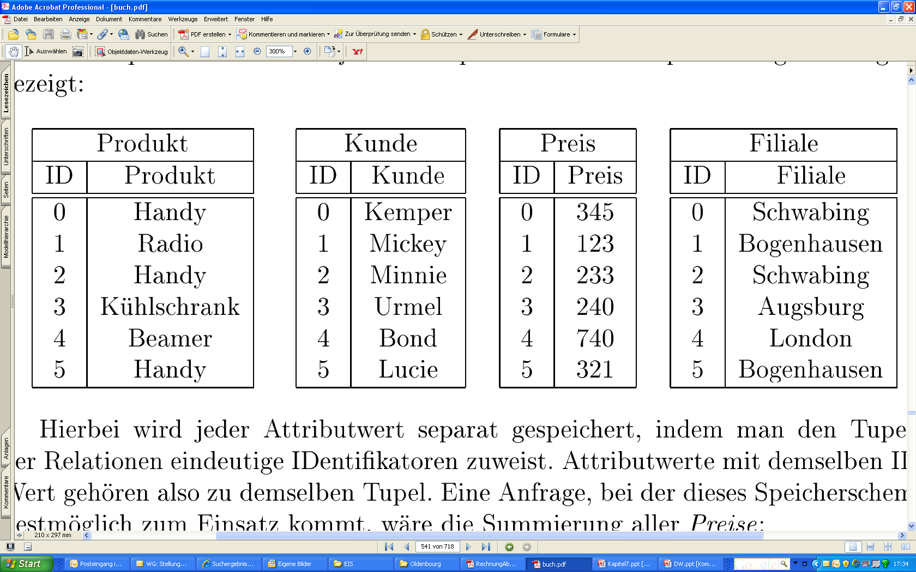
Row Store versus Column Store

Slide 16
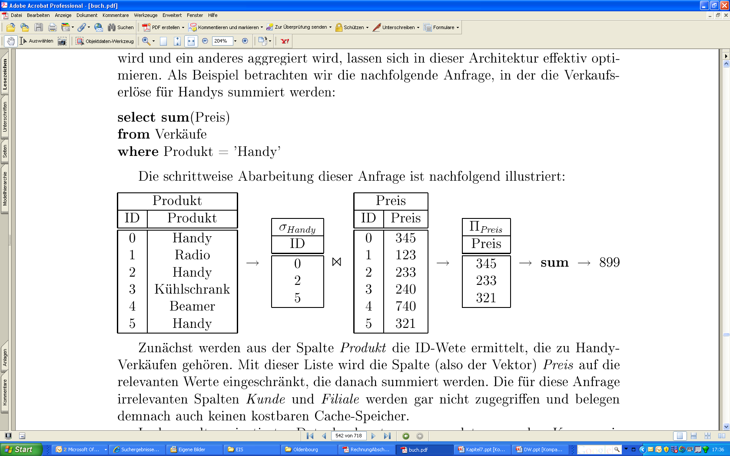
Anfragebearbeitung

Slide 17
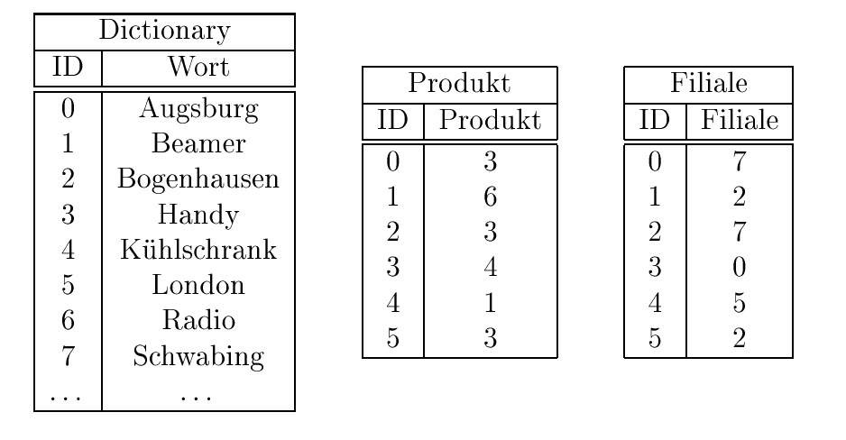
Komprimierung

Slide 18
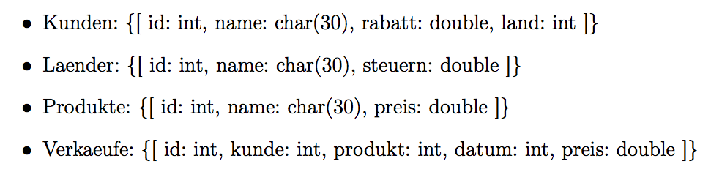

Datenstrukturen einer Hauptspeicher-Datenbank

Slide 19
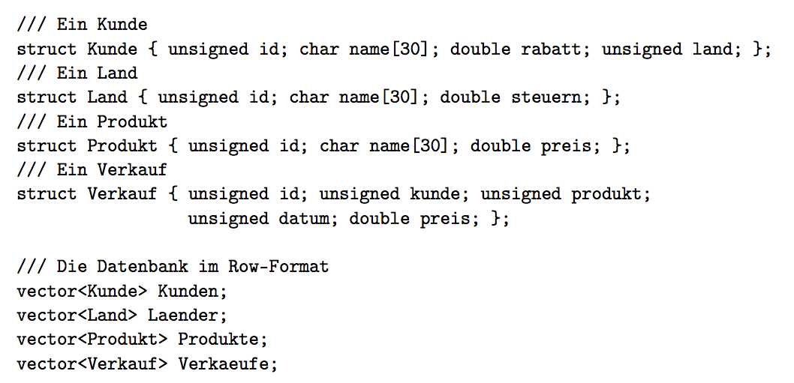
Row-Store-Format

Slide 20
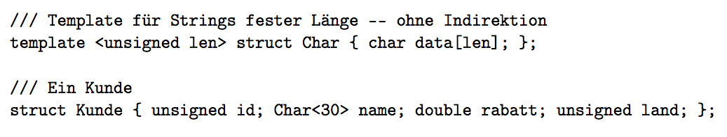
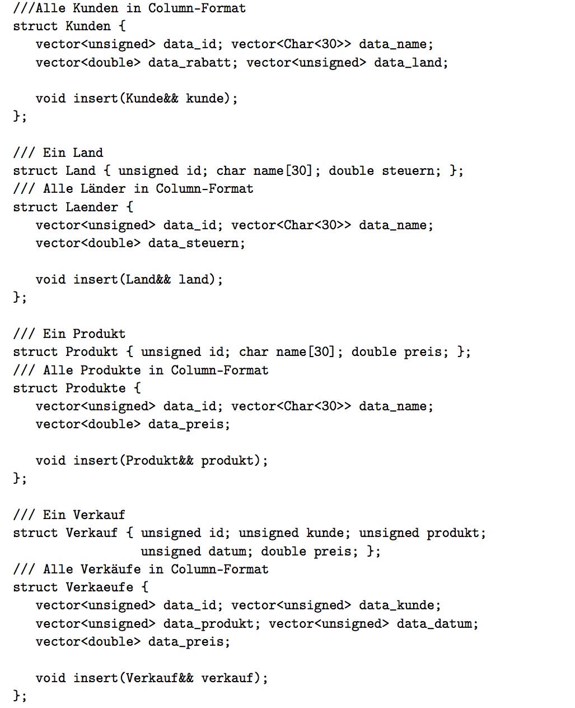
Column-Store-Format

Slide 21
Column-Store-Format (cont‘d)

Slide 22
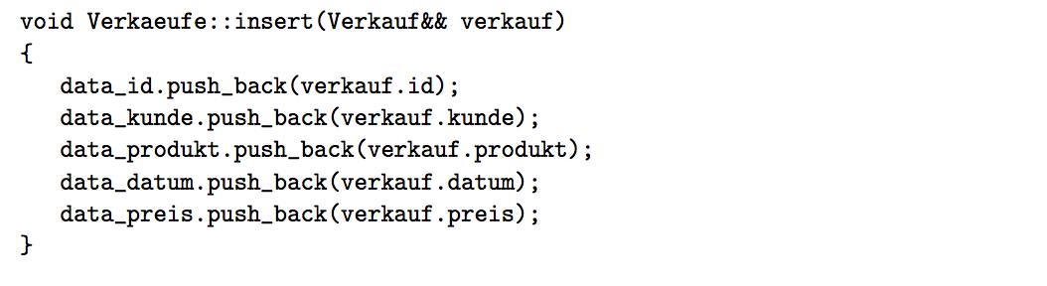
Einfügeoperation eines Tupels
Insert into Verkaeufe values (12, 007, 4711, 27.50)

Slide 23

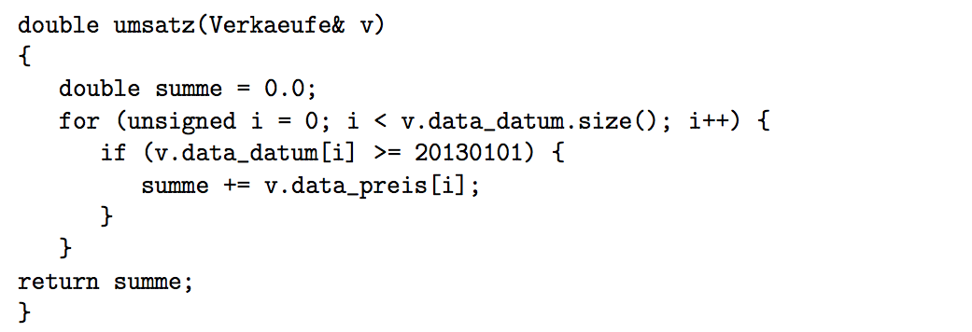
Anfragen

Slide 24
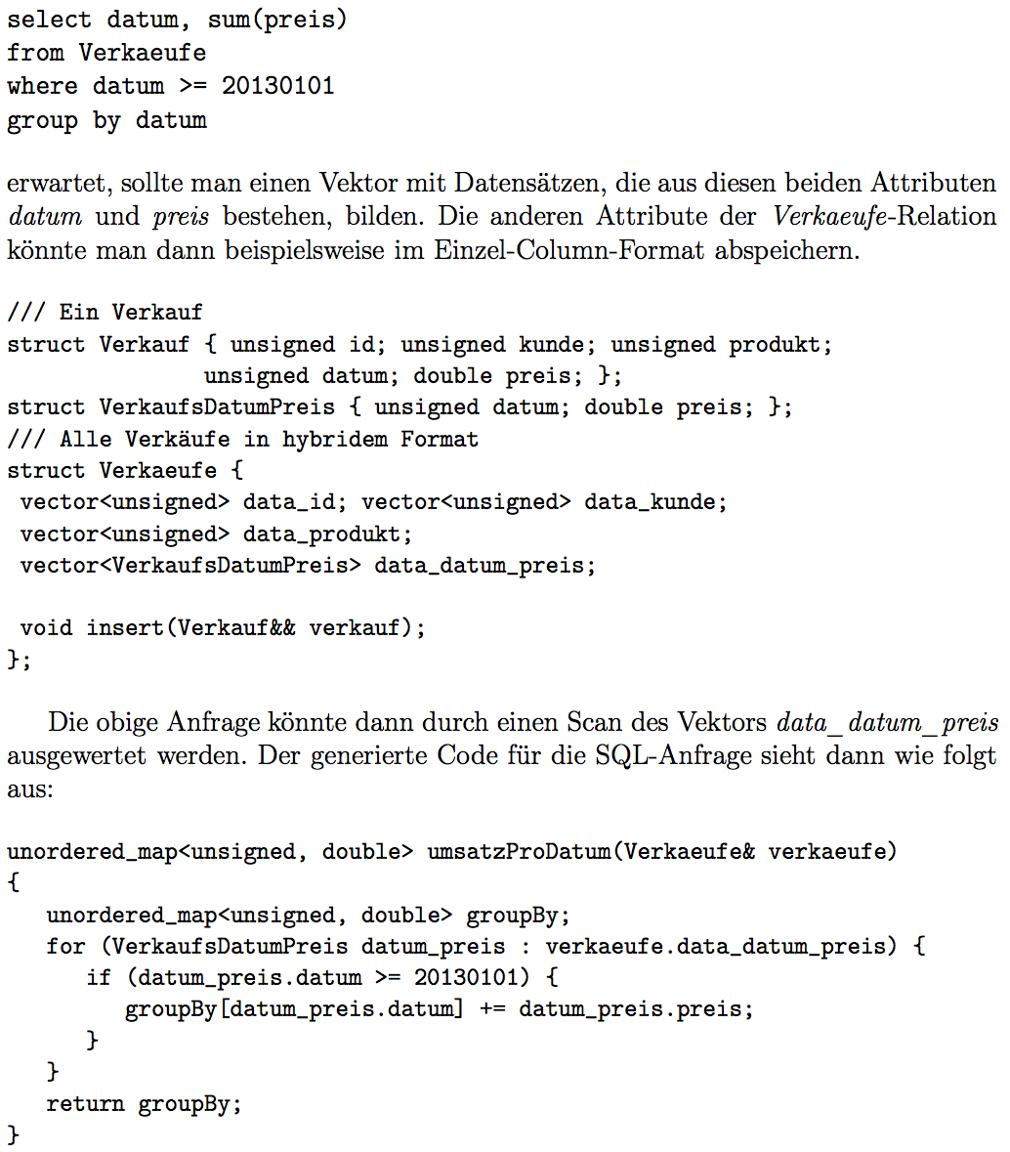
Hybrides Speichermodell

Slide 25
Anfragebearbeitung

Slide 26
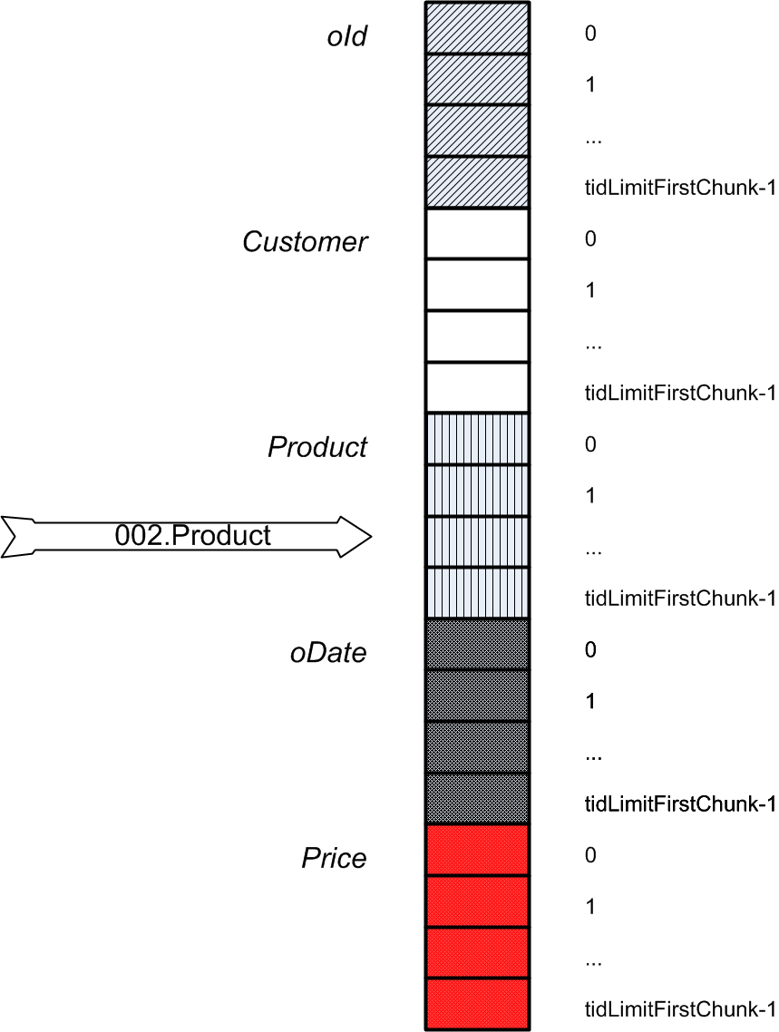
HyPer ist ein
Column Store
create table myOrders (
oId int,
Customer int,
Product int,
oDate date,
Price decimal(10,2))

Slide 27
Warum
Column-
Store?

Slide 28
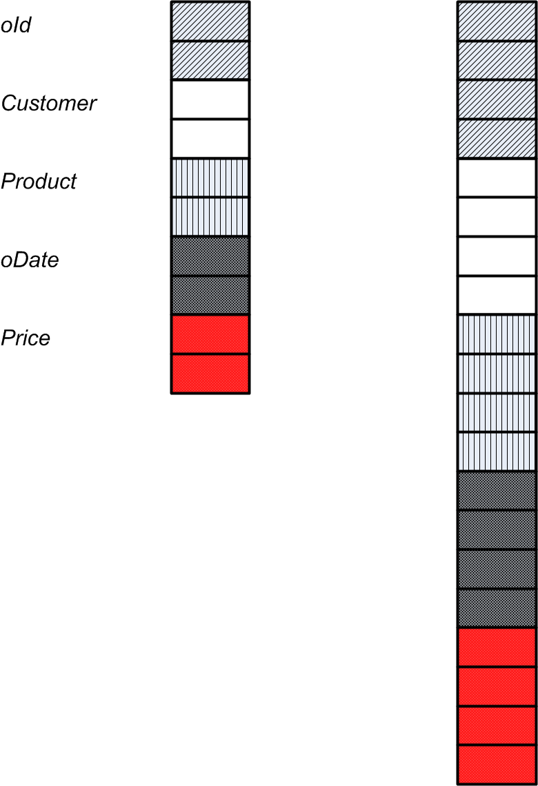
Dynamic Growth: Initially Doubling and Copying from 2⁴ to 2⁵ up to 2¹⁶
copy
copy
copy

Slide 29
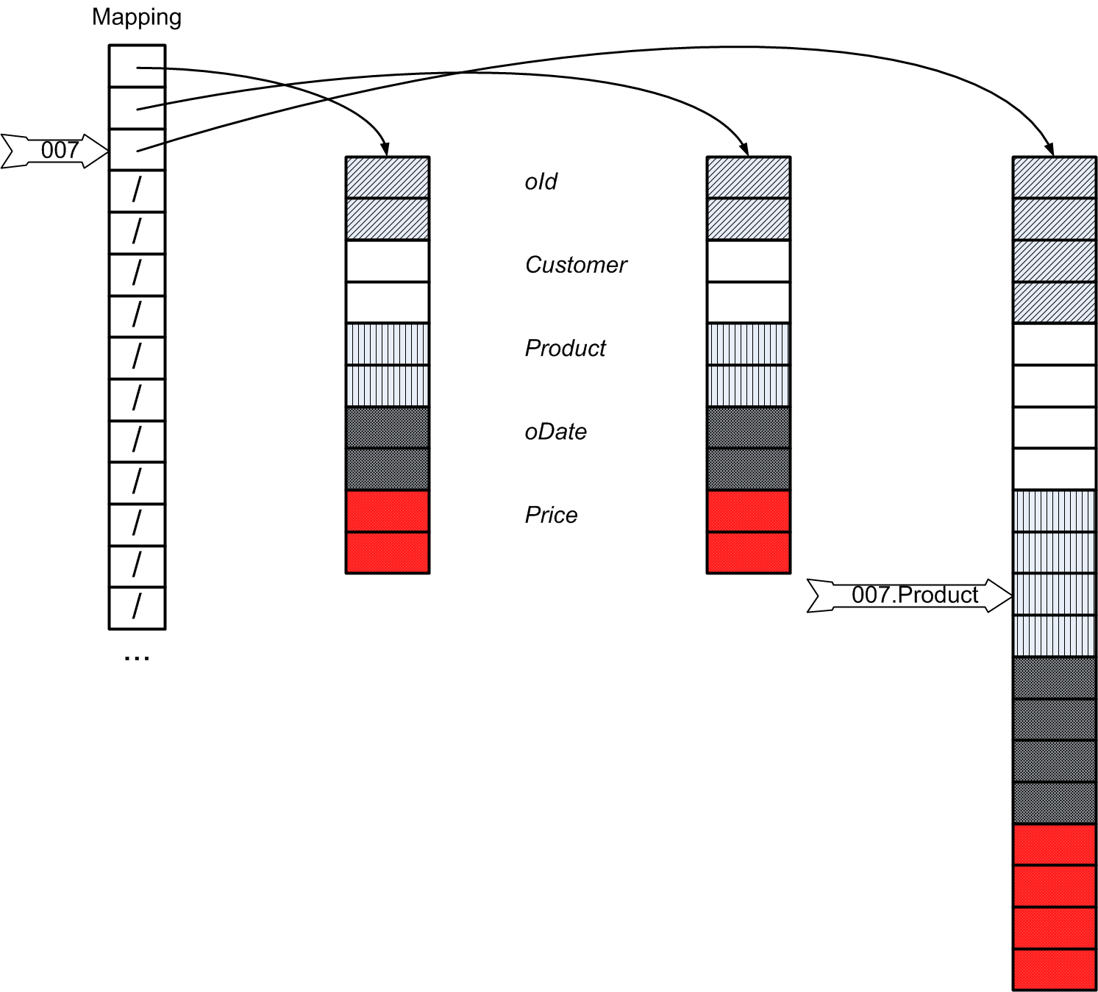
Beyond 2¹⁶: Data Partitioning and Dynamic Growth
#cols*2¹⁶
#cols*2¹⁶
#cols*2¹⁷

Slide 30
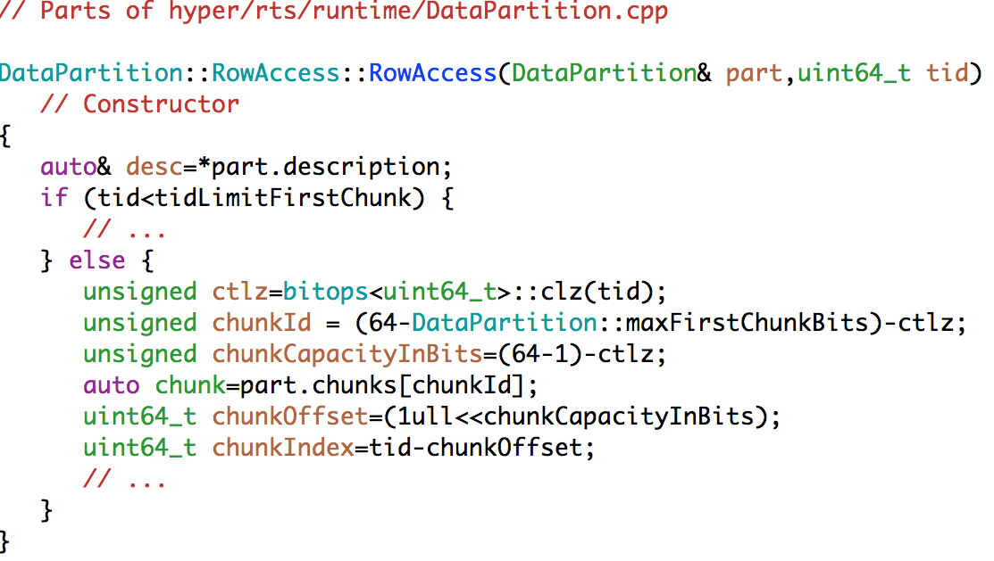
Data Partitioning and Dynamic Growth
2¹⁶
Efficient address
Transformation

Slide 31
Special Treatment of Strings:
→RuntimeString
Store short Strings inside the Data Vectors
  Length & actual string of length up to 12 bytes
For Long Strings the Data Vector contains
  Length of the string
  4 Byte Prefix of the string (➔short-cut for comparisons)
  Pointer to the String
Thus, strings always have fixed 16 byte representation in the Data Vector
/// The representation:
/// length (4 bytes), prefix (4 bytes, padded with null)
/// (pointer to string if length>12) or (rest of the string if length <=12)
union {
/// Representation as header+pointer
struct { uint64_t header; uint64_t pointer; } fullData;
/// Representation as length plus bytes
struct { uint32_t length; char payload[16-4]; } inlinedData;
};

Slide 32
Special Treatment of Strings:
→RuntimeString
Thus, strings always have fixed 16 byte representation in the Data Vector
/// The representation:
/// length (4 bytes), prefix (4 bytes, padded with null)
/// (pointer to string if length>12) or (rest of the string if length <=12)
union {
/// Representation as header+pointer
struct { uint64_t header; uint64_t pointer; } fullData;
/// Representation as length plus bytes
struct { uint32_t length; char payload[16-4]; } inlinedData;
};
5
short
uint64_t header
14
very
verylongstring

Slide 33
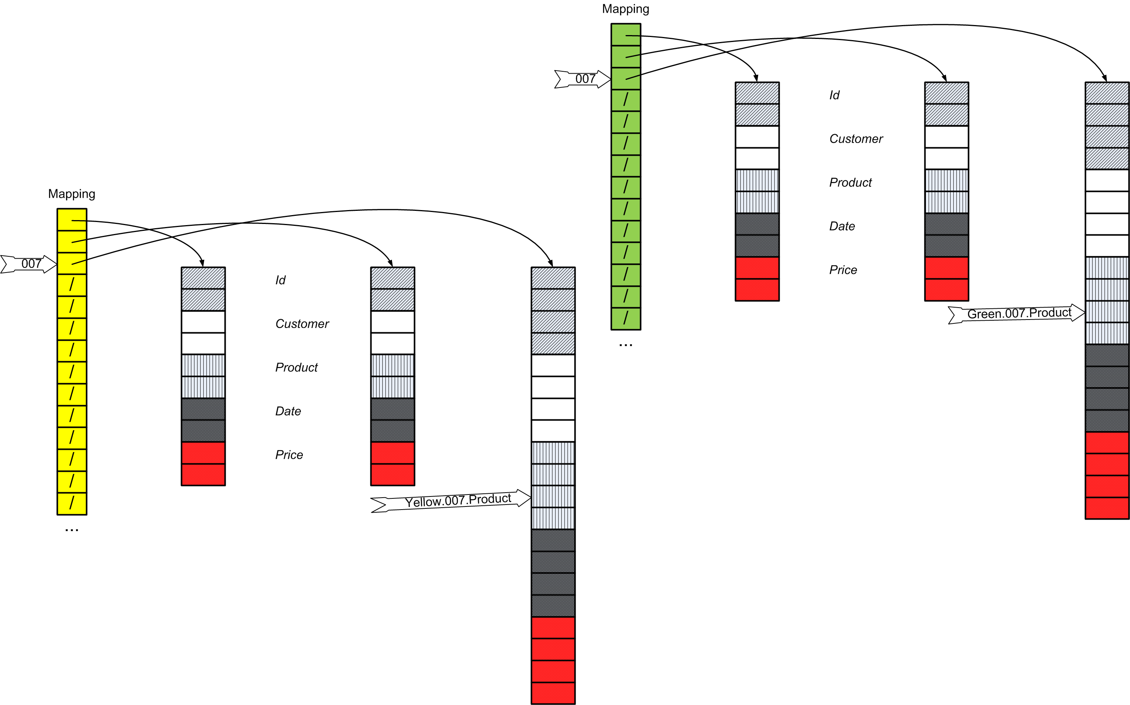
NUMA (Non Uniform Memory Architecture) Support: Partitioning
Yellow Socket
Green Socket

Slide 34
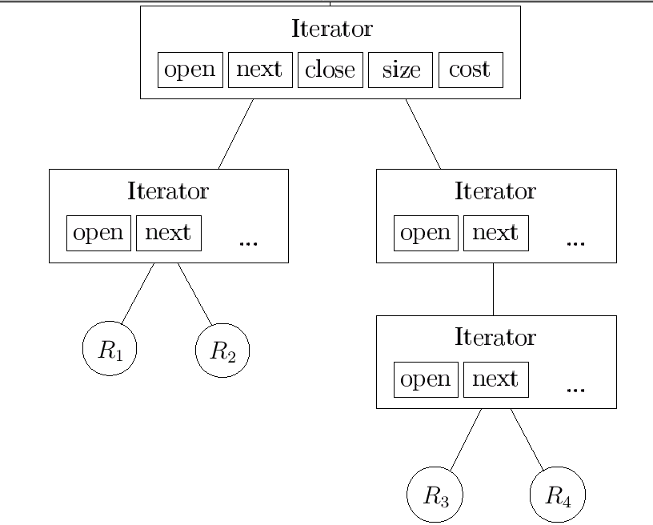
Traditional Pull-based (Volcano-Iterator-based) Query Processing
next
open
Return
Result

Slide 35
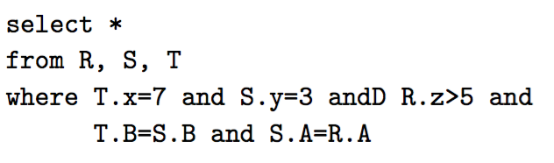

HyPer`s Data-Centric Code Generation

Slide 36
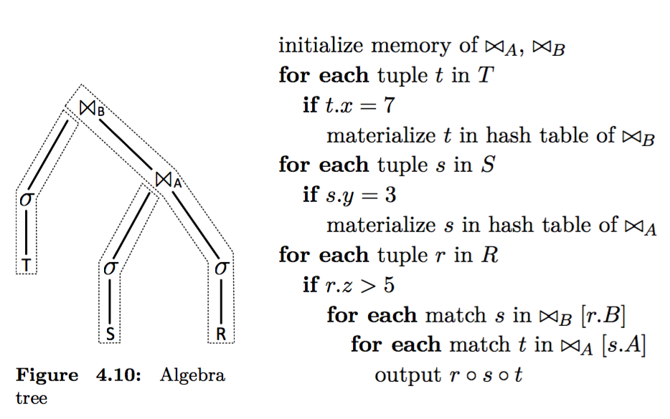
Pipelines are compiled into holistic data-centric
LLVM code fragments

Slide 37
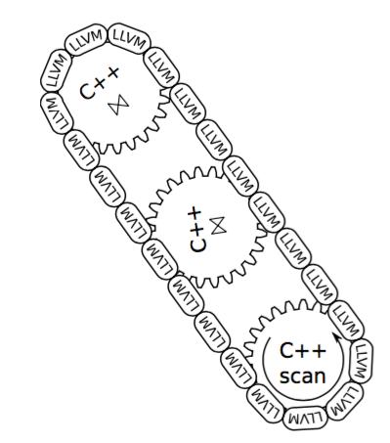
Not all code is dynamically generated: Interplay of pre-defined C++ code and dynamically generated LLVM

Slide 38
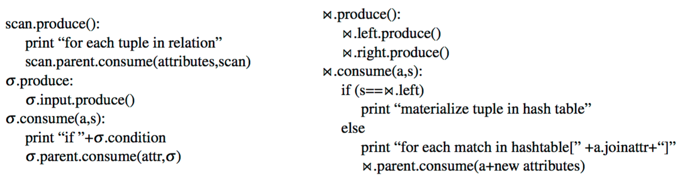
Abstraction of the Query Compiler: Produce/Consume
produce()
  generates code to compute the result tuples of the operator
consume(attrs,source)
  Generates code for processing one tuple
Compile time operations
  Not called at run time
Simple interface (just like the iterator model)
  However code generation functions; not processing functions

Slide 39
Pipelines are compiled into holistic data-centric
LLVM code fragments
produce()
produce()
c
produce()
consume()

Slide 40
Generating efficient code for modern Processors
The pipeline code that is generated by the
consume() and
produce()
is machine-agnostic (i.e., is independent of the processor on which it is executed)
This is the benefit of using the machine-independent compiler framework LLVM (Low Level Virtual Machine)
LLVM optimizes the generated code for the particular target machine
However, this does not optimize the execution for
  massively parallel execution on multi-core machines
  local processing on NUMA (non-uniform memory access) machines where DRAM is segmented into multiple regions
This is built into the runtime execution system of HyPer

Slide 41
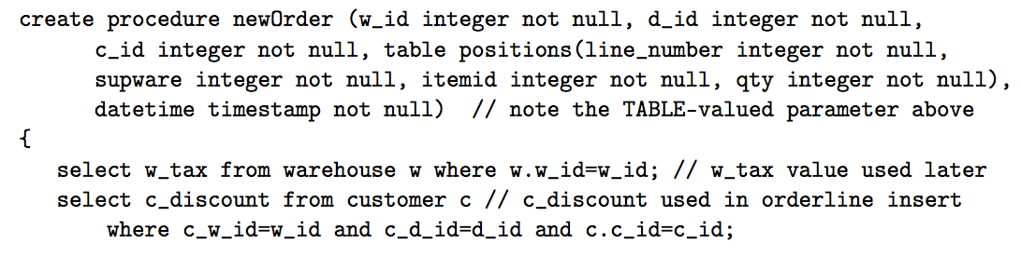
Anwendungsoperationen in der Datenbank:
Stored Procedures

Slide 42
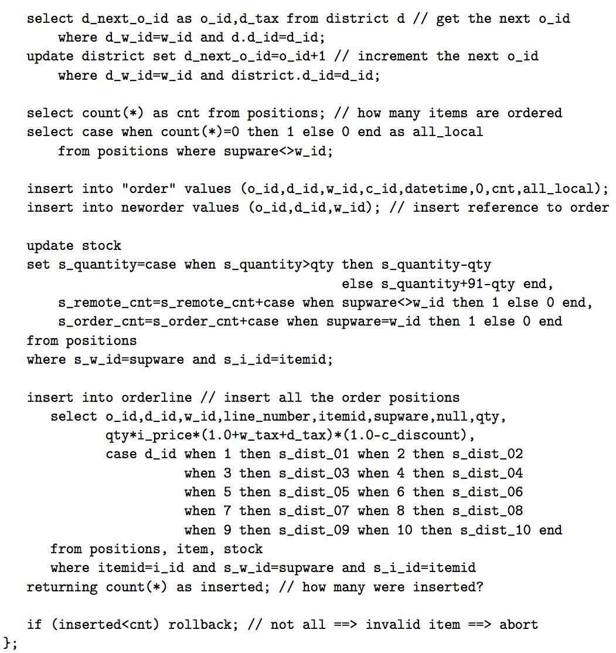

Slide 43
Snapshots für Anfragen
Snapshot der Haupt-Datenbank
OLAP
Haupt-Datenbank
OLTP

Slide 44
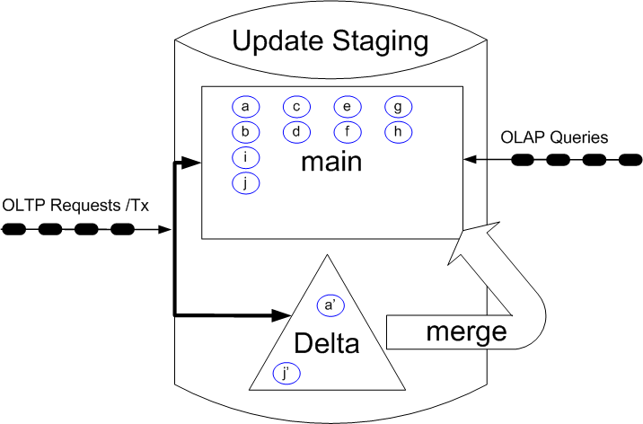
Update Staging: In vielen Systemen verwendet, zB. Hana von SAP

Slide 45
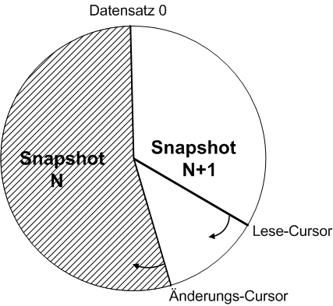
Scan-only Datenbanken: ISAO von IBM oder
Crescando von der ETHZ

Slide 46
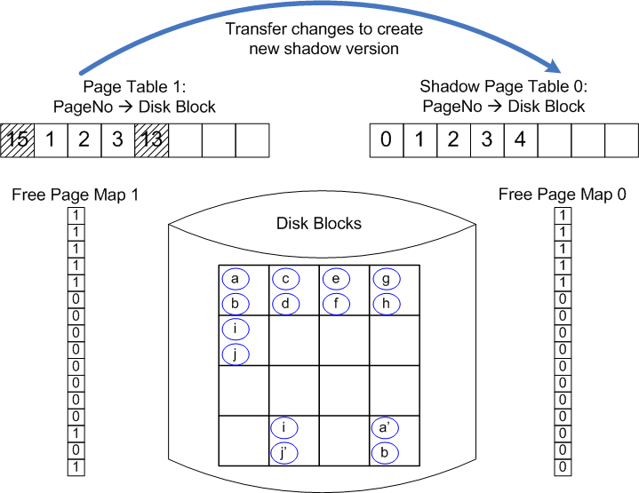
Ursprüngliches Schattenspeicher-Verfahren: Lorie77 für IBM System R

Slide 47
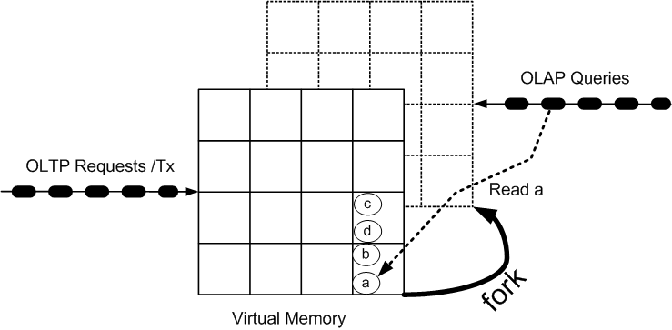
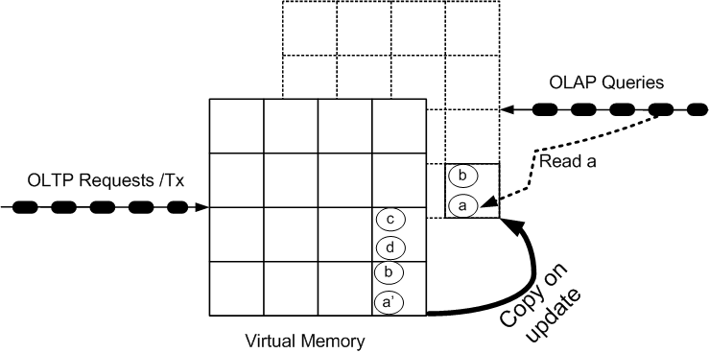
Copy on Write
Update a→a‘
2 µs

Slide 48
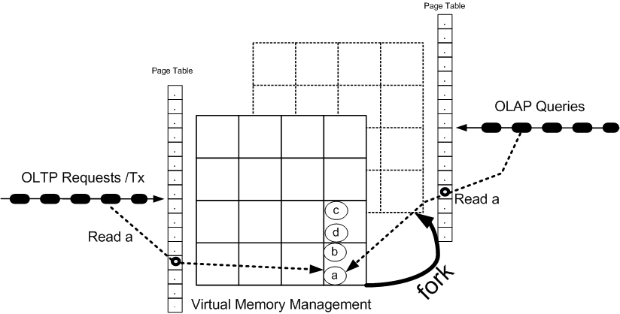
Snapshotting via fork-ing: Details

Slide 49
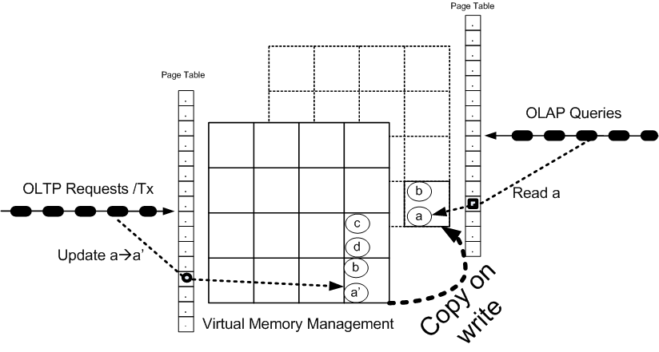
Snapshot Maintenance: copy on write

Slide 50
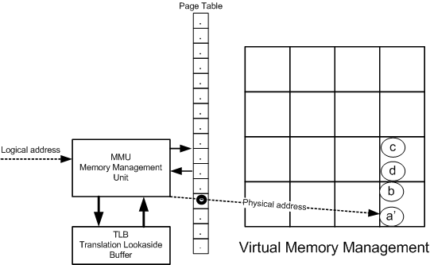
Fast because of Hardware-Support: MMU

Slide 51
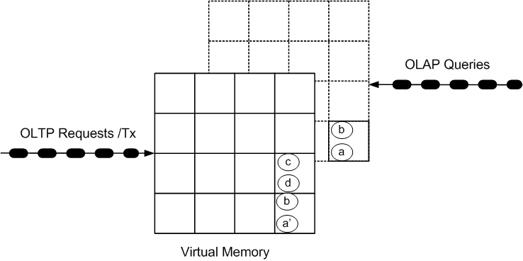
OLAP Queries on Tx-Consistent Snapshots

Slide 52
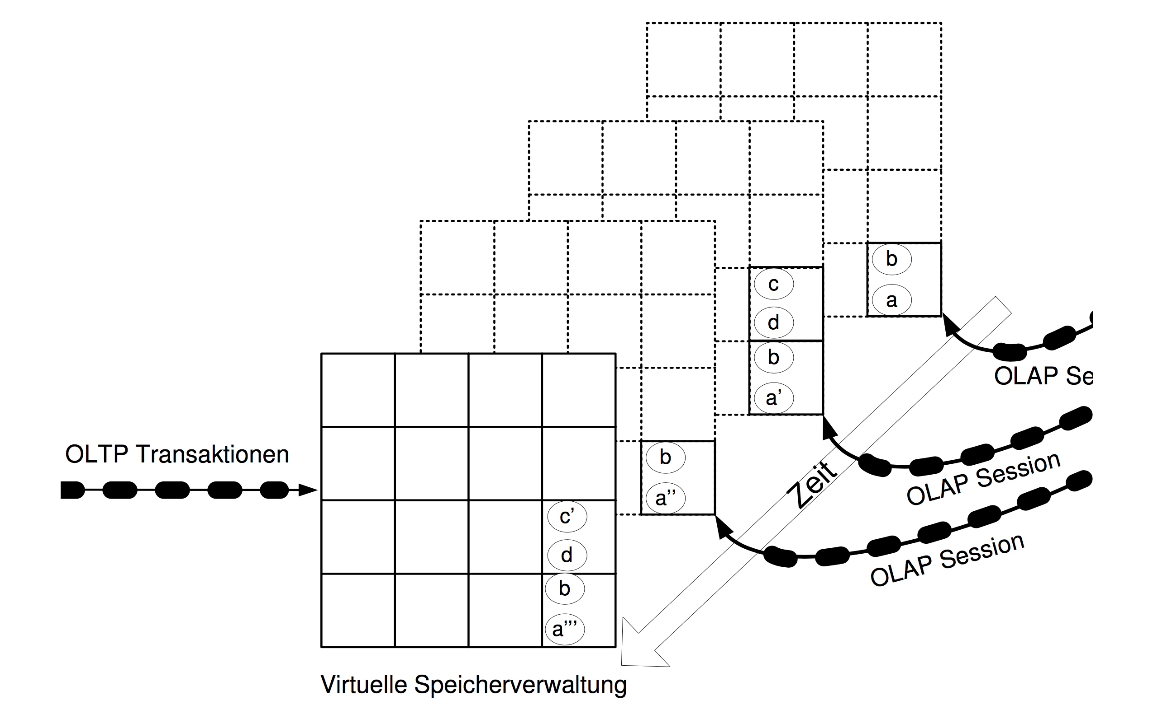
Multiple Query Sessions

Slide 53
Synchronization-Assertions
Serializability of the OLTP Transactions
  What else if executed serially
  We support full ACID → see coming slides
Snapshot isolation of the OLAP queries
  Multi-version mixed synchronization method
  Several OLAP queries form one Tx = OLAP Session
  Bernstein, Hadzilacos, Goodman: Chapter 5.5

Slide 54
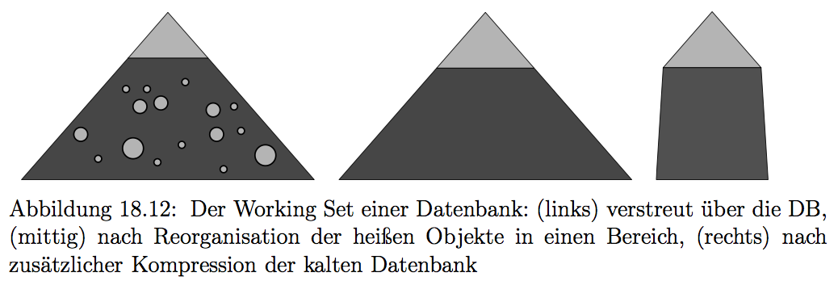
Kompaktifizierung: Motivation

Slide 55
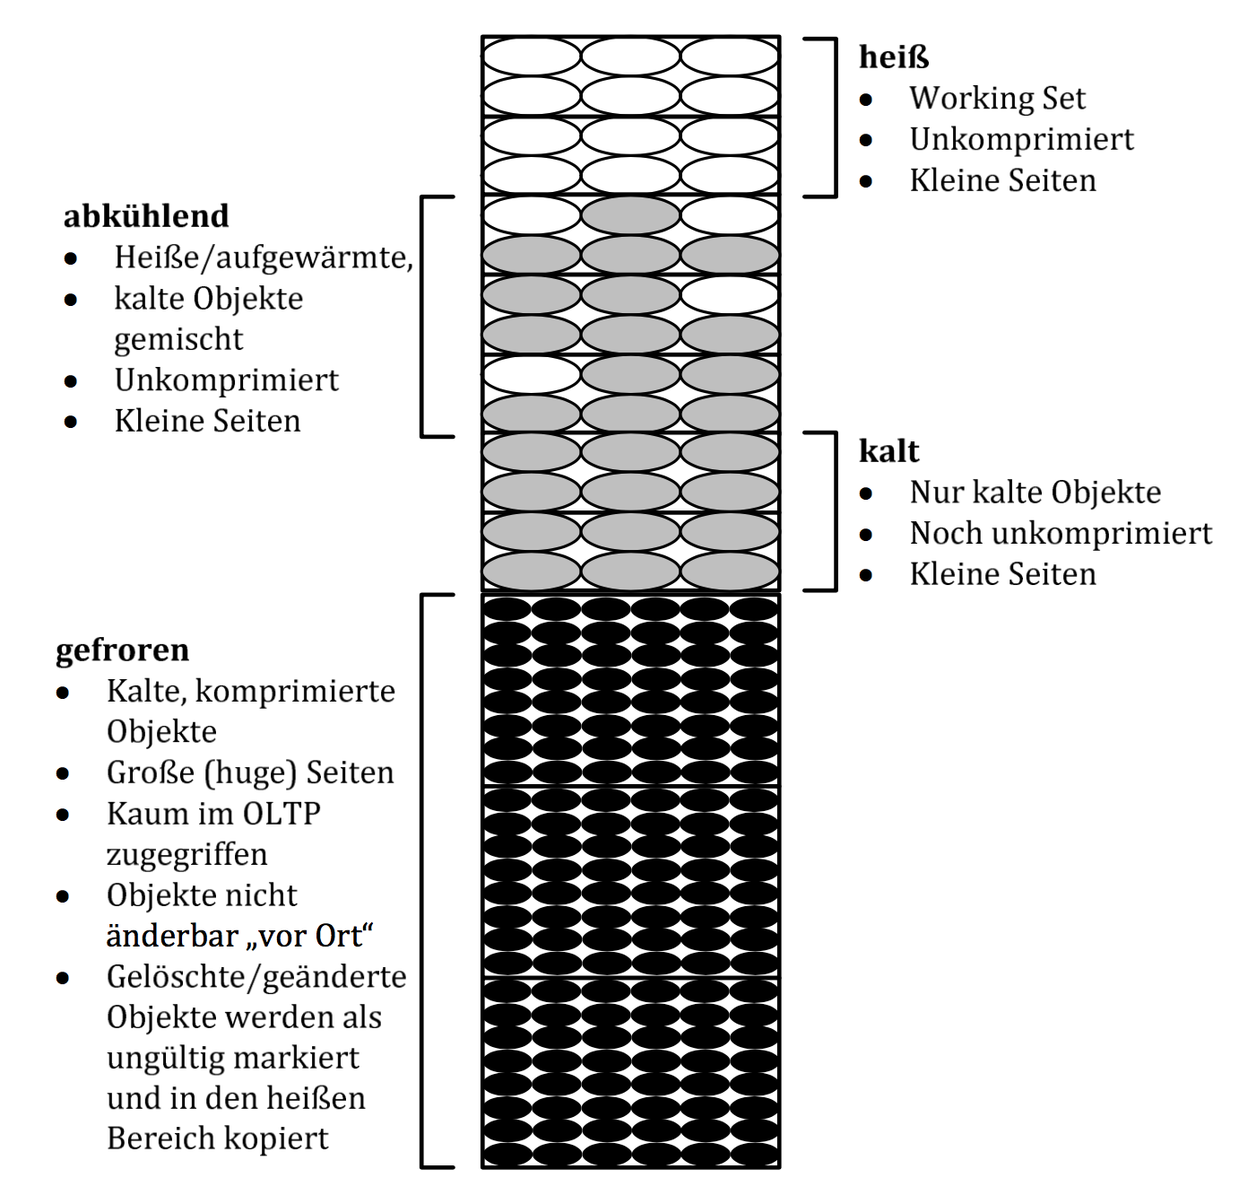
Kompaktifizierung der Datenbank

Slide 56
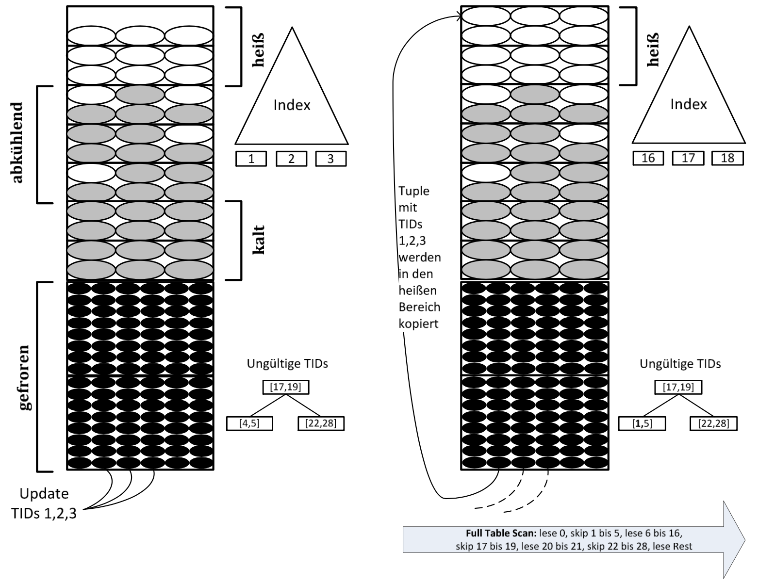
Invalidierung gefrorener Datenobjekte

Slide 57
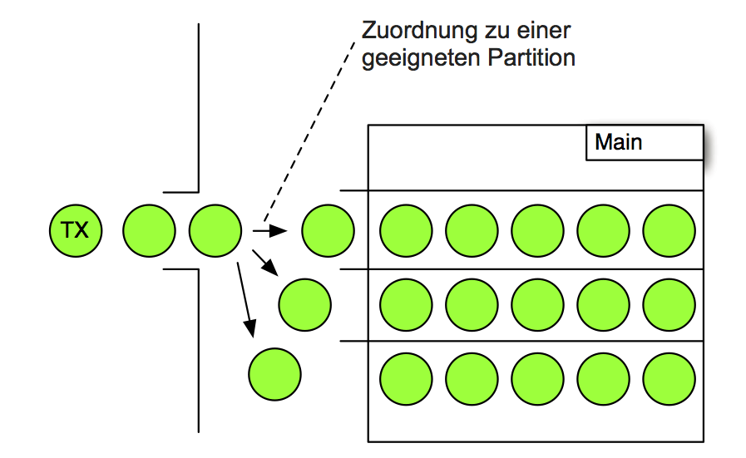
Transaktionsverwaltung: serielle Ausführung auf Partitionen

Slide 58
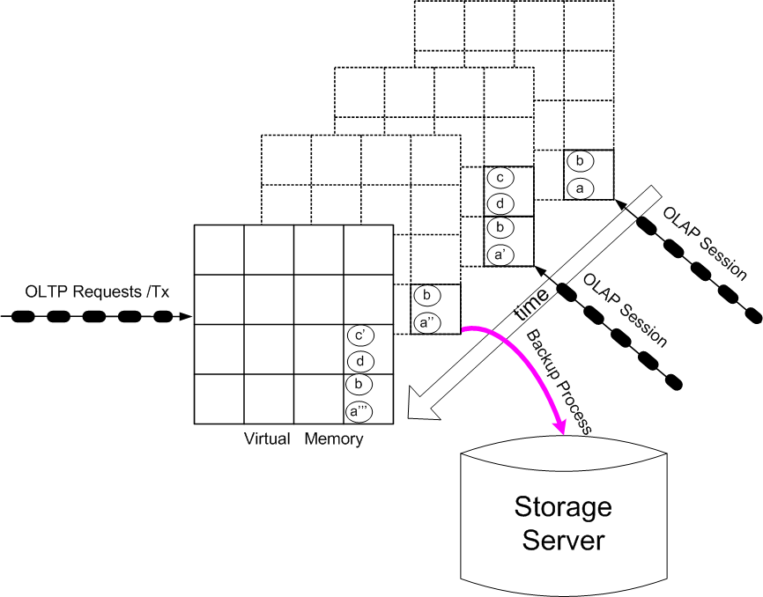
Snapshot used
for Tx-consistent
Backup

Slide 59
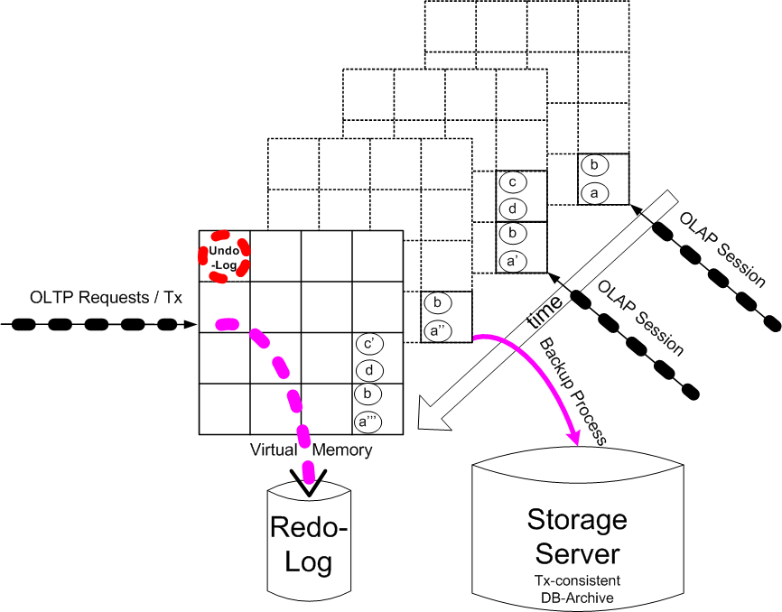
Logging the Transaction
Processing
To Storage Server via 10 Gb/s rDMA Interface (e.g. Myrinet or Infiniband)

Slide 60
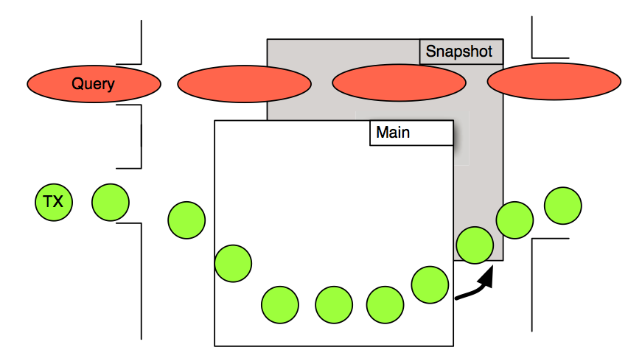
Isolation von OLAP und OLTP

Slide 61
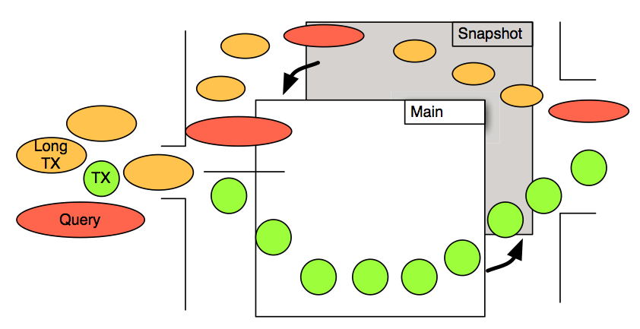
Tentative Ausführung langer Transaktionen

Slide 62
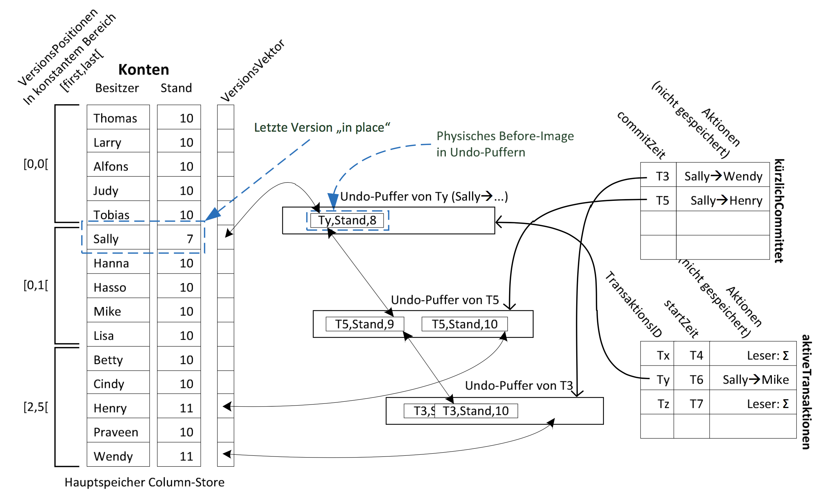
MVCC: Multi-Version Concurrency Control

Slide 63
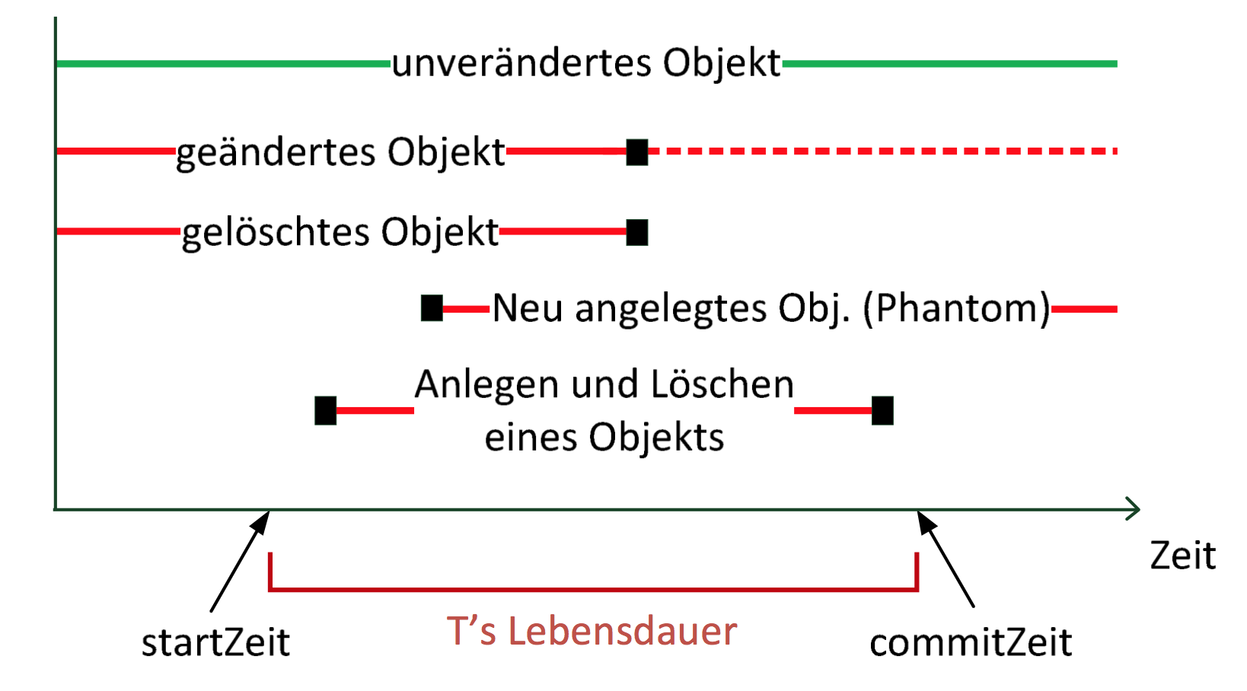
Validierung einer Update-Transaktion

Slide 64
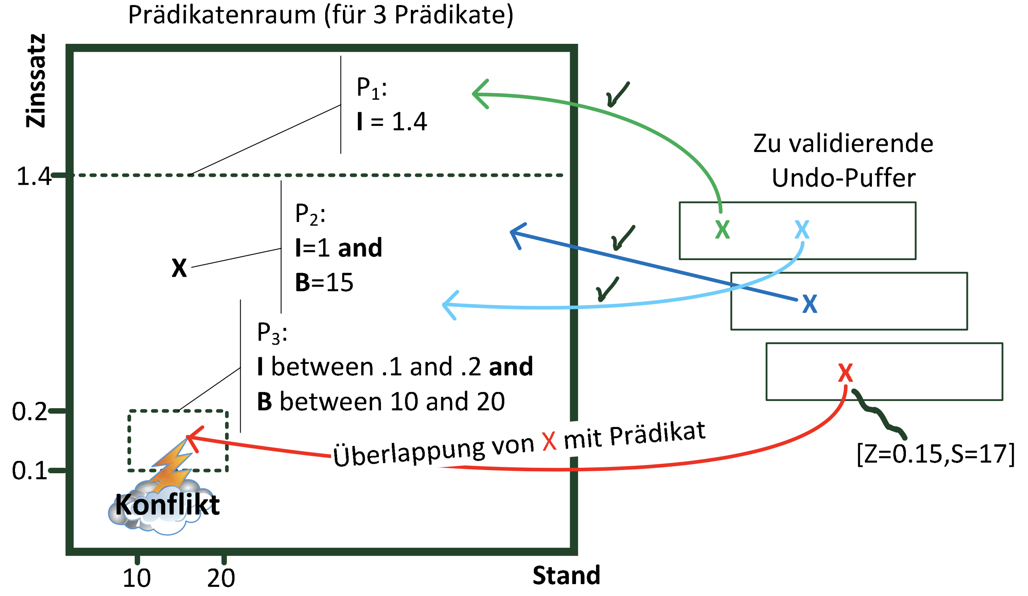
Precision Locking: Prädikatprüfung

Slide 65
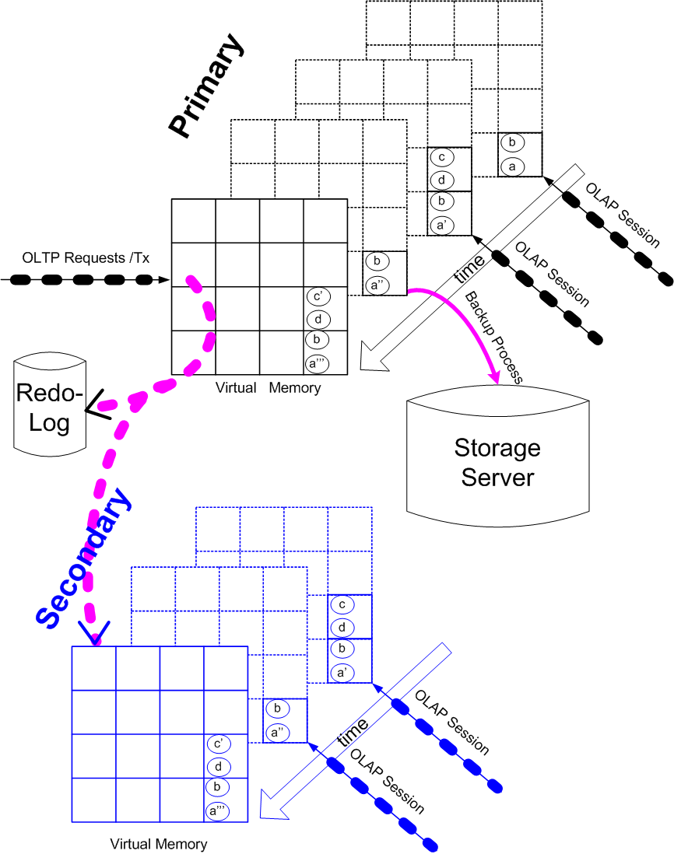
High Availability &
Load Balancing
Stand-By for OLTP
Active for OLAP
Possible for Backup

Slide 66
Row-Store
A | B | C | D | E | F
Column-Store
A
B
C
D
E
F

Slide 67

Indexstrukturen für Hauptspeicher-Datenbanken
Radix-Baum / Trie / Präfixbaum

Slide 68

Idee des Adaptiven Radix-Baums ART

Slide 69

Adaptive
Knoten des ART-
Baums

Slide 70
Join-Berechnung
Cache-Lokalität
Mehrkern-Parallelität
NUMA-Berücksichtigung
Synchronisations-freie Parallelität

Slide 72

Grundidee des hoch-parallelen Sort/Merge-Joins

Slide 73

Bereichs-
Partitionierung

Slide 74

Hochparallel Bereichs/Radix-Partitionierung

Slide 75
Range partitioning of private input
histogram of
worker W₁
prefix sum of
worker W₁
19=10011
19
19
9
<16
W₁
7 = 00111
4
0
7
≥16
→1
chunk of worker W₁
3
0
3
21
21
17 = 10001
2
1
W₂
17
17
2=00010
histogram of
worker W₂
prefix sum of
worker W₂
2
19
23
W₁
23
<16
→5
3
4
4
≥16
chunk of worker W₂
4
3
31
31
8
W₂
20
20
26
26
Notes:
Let me show you how it works using this example. There are two workers, each of them has a private input chunk of size 7. The key domain is from 0 to 31. We need to create two partitions so we take the first bit of the key to decide to which partition to scatter a tuple. This results in all keys smaller than 16 to be placed in the first partition and all keys between 16 and 31 in the second.
Instead of just copying the tuples to their new partition which would incur synchronization overhead, we precompute the target positions of the tuples. In a first pass through the data each thread computes a histogram stating how many of its tuples fall into which partition. Here again we use the first bit of each key as an index into the histogram. In our example four tuples of the first chunk fall into the first partition and three in to the second. From the second chunk three tuples belong to the first target partition and four to the second. Out of these histograms, each thread then computes prefix sums which denote the starting addresses within the target partitions. In our example, worker W1 begins writing at position 0 within the first and the second target partition. Worker W2 starts writing at position 4 within the first target partition as worker W1 scatters 4 tuples to this partition. Within the second partition, workers W2 begins writing at position 3 because the first three positions belong to worker W1.
This way, the two workers write to distinct positions within the target partitions and don‘t require any kind of synchronization. Each worker scatters its tuples according to its prefix sum and updates its prefix sum accordingly.
For example, the first tuple with key 19 belongs to the second partition. Workers W1 checks the second bucket of its prefix sum, updates the position and writes the tuple to the first position of the second partition. After all tuples have been scattered, the result looks like this.

Slide 76
Range partitioning of private input
histogram of
worker W₁
prefix sum of
worker W₁
19=10011
19
9
9
<16
W₁
7
7 = 00111
4
0
7
≥16
→1
3
chunk of worker W₁
3
0
3
1
21
17 = 10001
2
1
W₂
4
17
8
2=00010
histogram of
worker W₂
prefix sum of
worker W₂
2
19
23
W₁
21
<16
→5
3
4
4
≥16
17
chunk of worker W₂
4
3
31
23
8
W₂
31
20
20
26
26
Notes:
Radix partitioning bears some risks in case of skew. For uniform data, it is ok to use static partition bounds like we did it in the example. But if the data is skewed, this can result in totally different chunk sizes and thus unbalanced loads of the threads.

Slide 77

Real C hacker at work …

Slide 78

Paralleler Radix-Join

Slide 79

Mehrfache Partitionierung des Radix-Joins: Cache-Lokalität

Slide 80

Hash-Join-Teams: Globale Hashtabelle

Slide 81

NUMA-lokale Arbeitszuteilung:
„Häppchen“-weise (morsel driven)

Slide 82

Adaptive Dynamische Parallelisierung

Slide 83

Dispatcher: lock-free DS
Dispatcher
assigns preferrably socket-local morsels

Slide 84


Slide 85

Adaptive Parallelism

Slide 86

NUMA-local data processing

Slide 87

Building the
Hash Tables

Slide 88

Hash Table with small Bloom Filters

Slide 89

Parallel Sorting: (1) Sort locally (2) Determine Separators (3) Merge

Slide 90

Parallel Aggregation: (1) pre-aggregation (2) global grouping

Slide 91


Slide 92
Algorithmen auf sehr großen Datenmengen
R ∩ S
R
2
3
44
5
78
90
13
17
42
89
S
44
17
97
5
6
27
2
13
9
Nested Loop: O(N²)
Sortieren: O(N log N)
Partitionieren und Hashing

